Slide 1
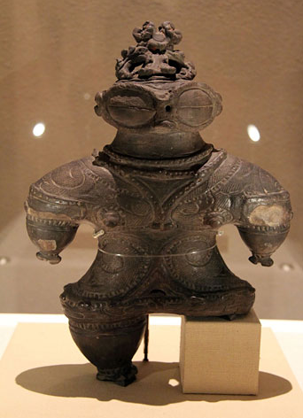
Japanese Culture Art
Japanese art entails a broad range of styles and means of expression such as ceramics, painting, sculpture and calligraphy on silk and paper (Satō, 2011).
The Ukiyo-e woodblock prints is the common type of Japanese art work.
Notes:
Japan has been the subject to sudden invasions of alien and new ideas followed by long times of contacts minimized with the outside world. With time, Japanese had developed the ability to absorb assimilate as well as imitate those elements which made there culture from foreign culture which complimented their aesthetic preferences. In Japan, the painting done by professional and amatuer are the preferred artistic expression.

Slide 2
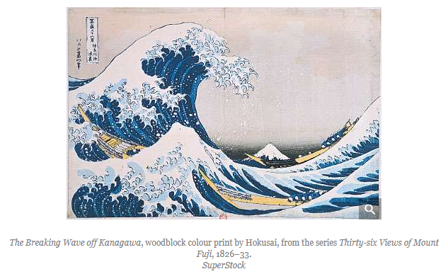
Japanese art (painting)
Japanese art for diversity class is made up of painting, pottery, architecture, jade carving and decorative visual arts (Rimer, 2011).
Notes:
The occasion of dramatically enhanced interaction with other cultures seems to need a convenient summary of Japanese aesthetic principles and Japanese art archaeologists and historians commence to build methodologies to assess and categorize a vast body of material ranging from Neolithic pottery to wood-block prints.

Slide 3
Characteristic of Japanese Art Culture
Most Japanese art culture has got the mark of extensive interaction outside forces
The Chinese tang international style was the key point of Japanese artistic creation in the 8th century.
Most theories were used to explain the development of Japanese culture (Satō, 2011).
Visual culture concerns cyclical design of assimilation, reaction and adaptation.
Notes:
The notion of cyclical assimilation and then assertion of independence requires extensive nauncing however. It should be recognized that, while there were periods in which either continental or indigenous art forms were dominant, usually the two forms coexisted.
Another pervasive characteristic of Japanese art is an understanding of the natural world as a source of spiritual insight and an instructive mirror of human emotion. An indigenous religious sensibility that long preceded Buddhism perceived that a spiritual realm was manifest in nature.

Slide 4
Cultural Institutions
The national government’s Agency for cultural affairs is accountable for enhancing and distribution of different aspects of culture
The agency also assist in preserving Japanese Cultural art for advanced class (Rimer, 2011).
The cinema has been the most successful at taking a western form and putting it through a Japanese aesthetic filter to give a distinctive style, internationally acclaimed Japanese film.
Notes:
The Japanese are among the most literate peoples in the world. The National Diet Library in Tokyo (which also includes branch libraries) is the single largest library in Japan. The concept of the public lending library, however, is fairly new in Japan, which partially explains the country’s high incidence of commercial book sales.
Most of Japan’s major cultural institutions—including the Japan Academy, the Tokyo National Museum, and the National Theatre—and many of its most prestigious universities—e.g., the public University of Tokyo and private Waseda and Keio universities—are located in Tokyo. Japan’s numerous Buddhist temples also contain a great many cultural properties, especially those located in Kyōto and Nara. In addition to the many public institutions, there are numerous private museums, art galleries, theatres, and gardens throughout the country, and Japanese department stores also play a role in the dissemination of culture by offering free or low-cost exhibitions.

Slide 5
References
Rimer, J. T. (Ed.). (2011). Since Meiji: perspectives on the Japanese visual arts, 1868-2000. University of Hawaii Press.
Satō, D. (2011). Modern Japanese art and the Meiji state: The politics of beauty. Getty Publications.

